Slide 1
HTGB & HTRB Life TEST FBG20N18

Slide 2
DC LIFE
Tested variations of VDS and VGS voltages over several temperatures over a 2000Hrs timeframe
VDS Tested : 200V, 230V, 250V at Temperatures of 100C and 130C
VGS Tested : 6V, 6.75V, 7.25V at Temperatures of 100C and 150C
Parts tested with full parametric test on Focused tester at interim steps 24hrs, 48,hrs, 96hrs, 210hrs, 500hrs, 1000hrs, 1500hrs, 2000hrs
Parts with very high leakage were removed at each step
X axis (voltage represents Applied stress voltage not test voltage)

Slide 3
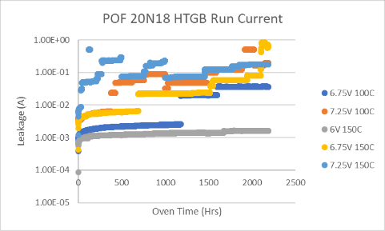
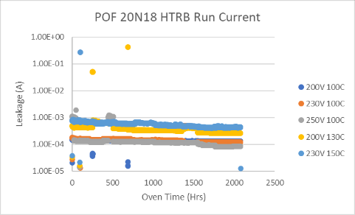
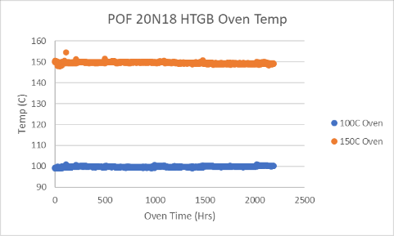
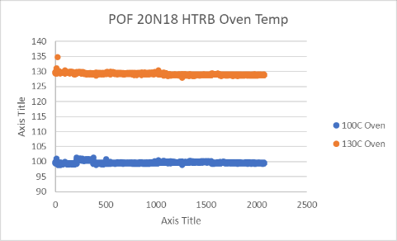
OVEN LOGS

Slide 4
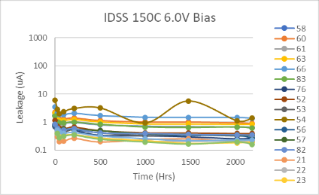
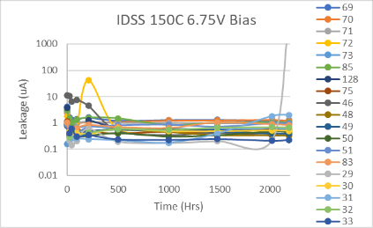
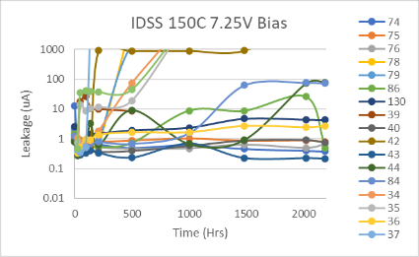
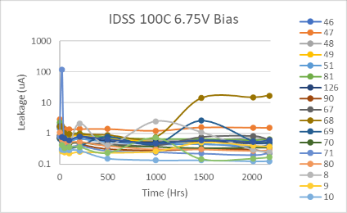
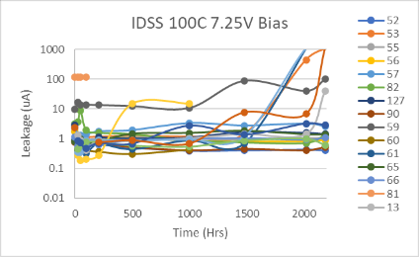
HTGB LIFE
IDSS tested at 200V

Slide 5
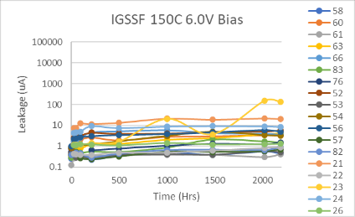
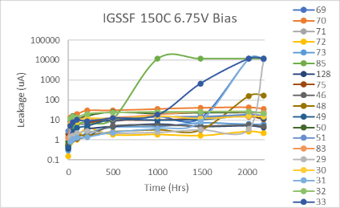
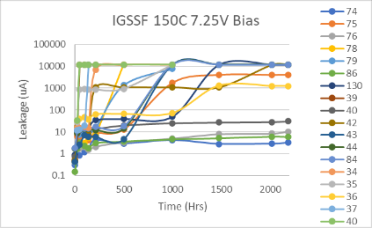
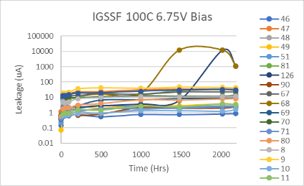
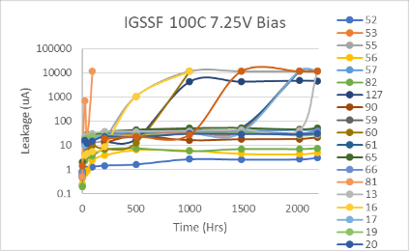
HTGB LIFE
IGSSF tested at 5V

Slide 6
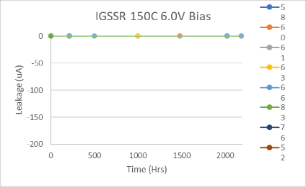
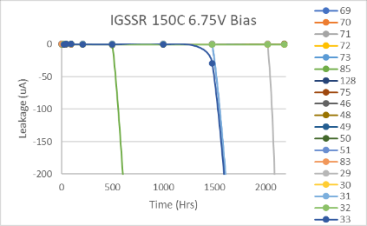
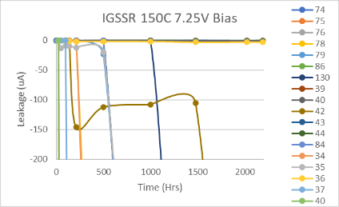
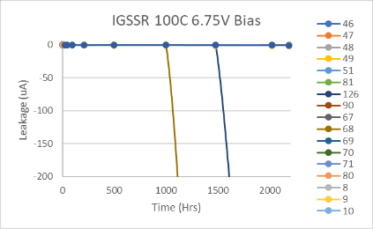
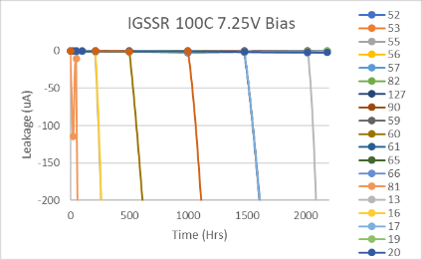
HTGB
IGSSR tested at -4V

Slide 7
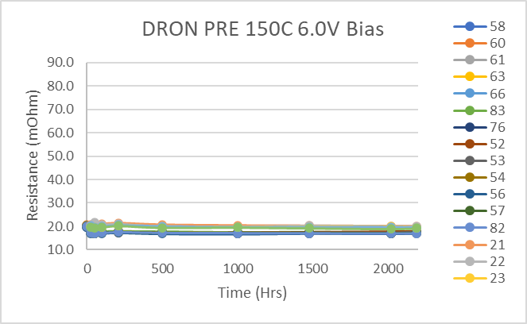
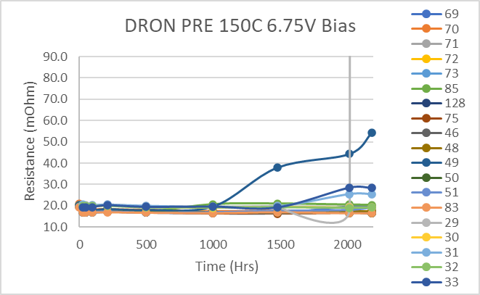
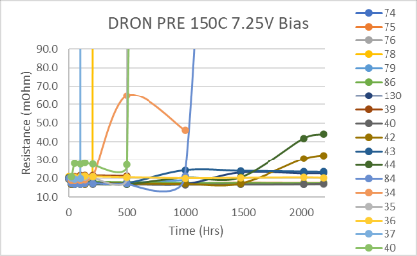
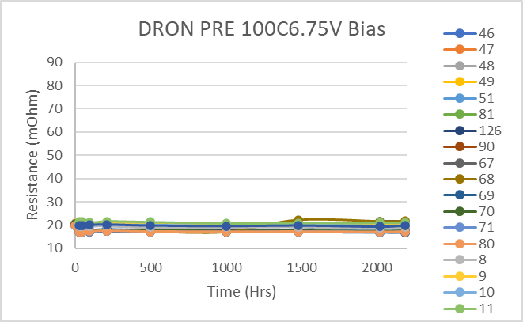
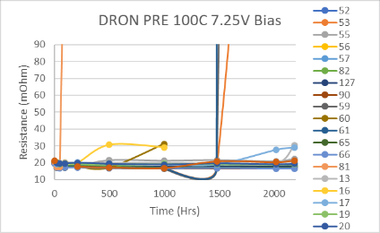
HTGB
DRON pre at 15A VGS@5V

Slide 8
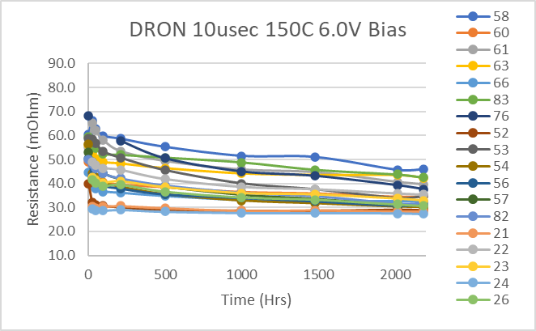
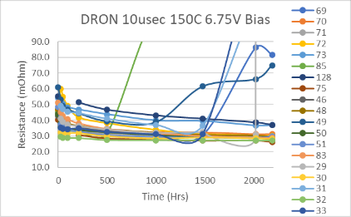
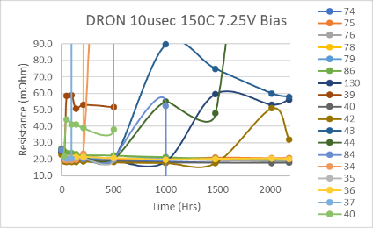
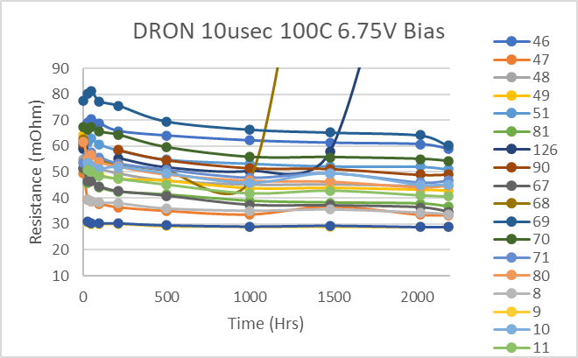
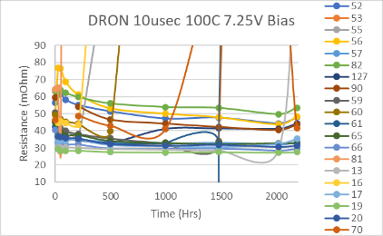
HTGB
DRON post at 15A VGS@5V
10s stress at 160V followed by
Test at 5-8us after removal

Slide 9
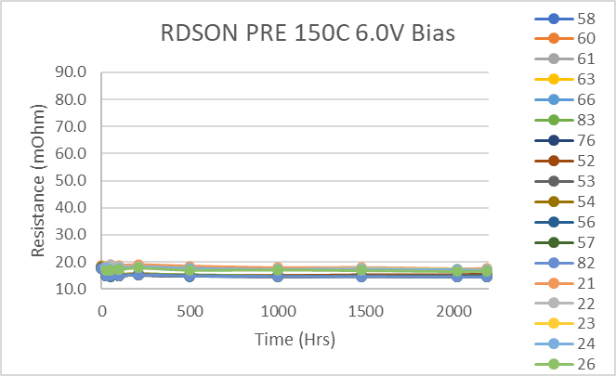
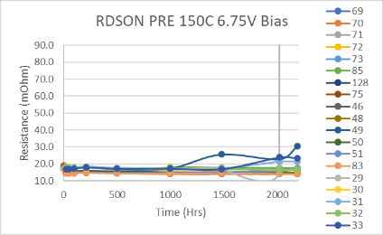
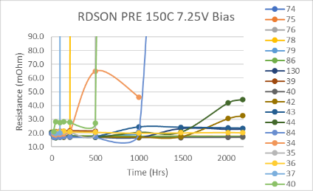
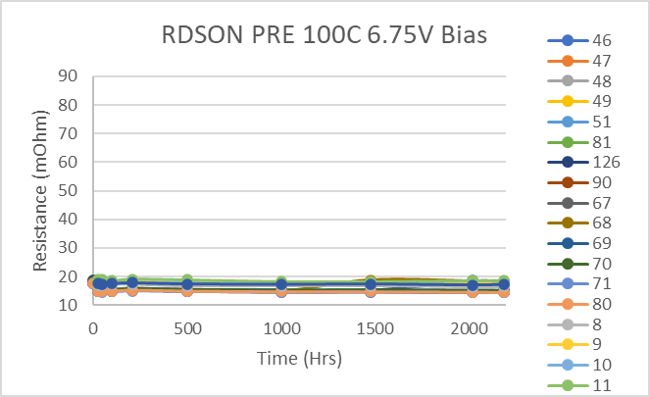
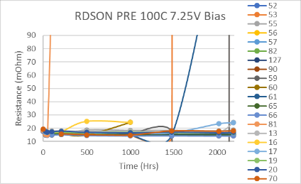
HTGB
RDSON at 18A VGS@5V

Slide 10
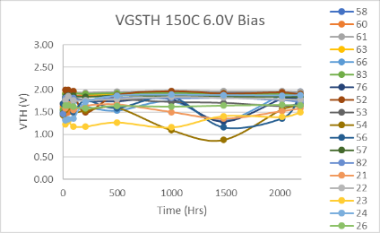
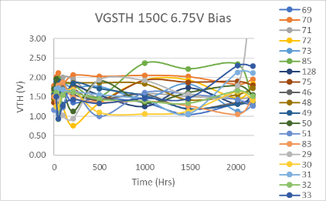
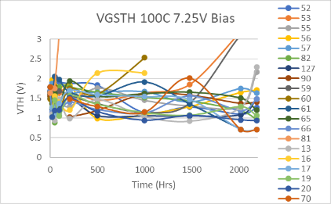
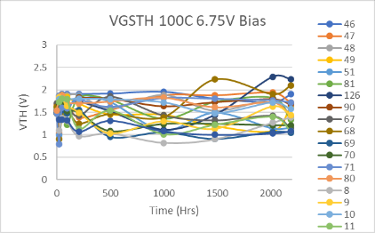
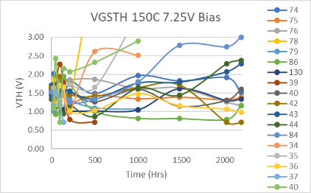
HTGB
Vgsth at 3mA

Slide 11
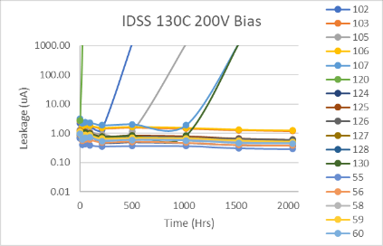
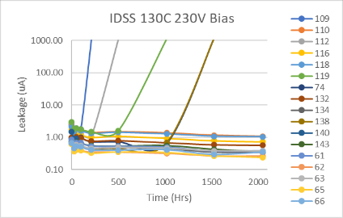
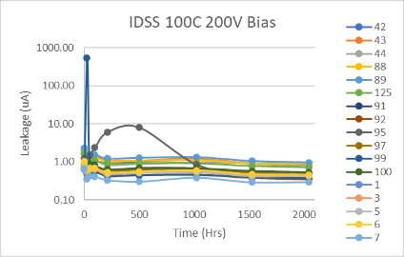
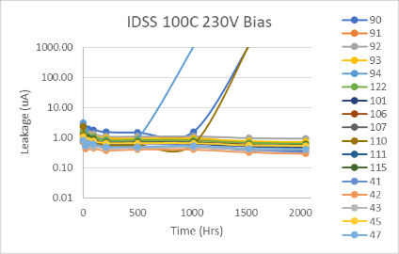
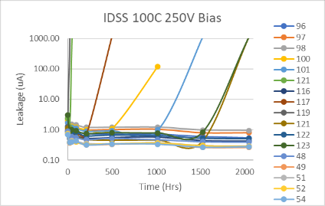
HTRB
IDSS tested at 200V

Slide 12
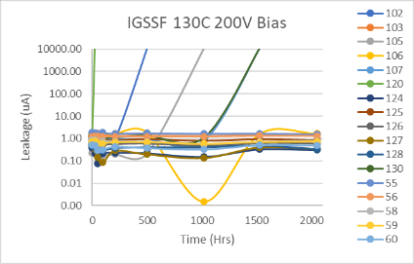
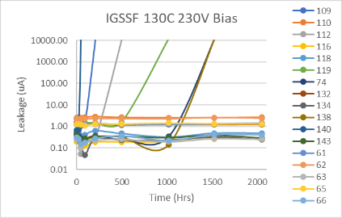
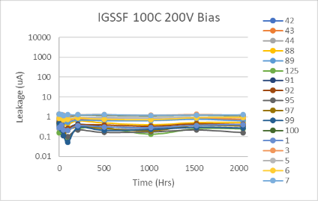
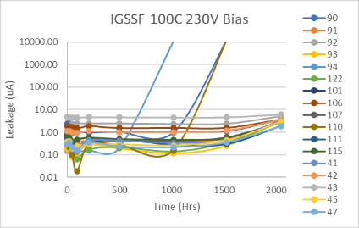
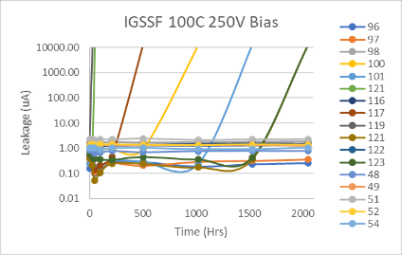
HTRB
IGSS tested at 5V

Slide 13
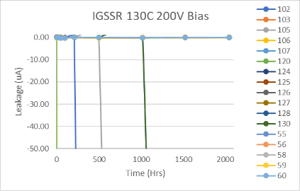




HTRB
IGSR tested at -4V

Slide 14





HTRB
DRON pre at 15A VGS@5V

Slide 15





HTRB
DRON post at 15A VGS@5V
10s stress at 160V followed by
Test at 5-8us after removal

Slide 16





HTRB
RDSON at 18A VGS@5V

Slide 17




HTRB
Vgsth at 3mA

Slide 18
LIFE TEST SUMMARY HTGB
Temp | Stress V | Time(Hrs) | SN | Wafer # | Notes
100C | 6.75
 |  | 1479 | 68 | Q211 | High IGSS, still functional-part was OOF
 |  | 2020 | 126 | Y003 | High IGSS, still functional-OOF replacemnt actual hours 1924
 | 7.25 | 96 | 81 | Q211 | Out of Family, High IGSS,IDSS, Vth - Part was OOF
 |  | 500 | 16 | Y046 | High IGSS -removed 1000Hrs
 |  | 1000 | 55 | Y003 | High IGSS, still functional
 |  |  | 60 | Q211 | High IGSS -removed 1000Hrs
 |  |  | 127 | Y003 | High IGSS, still functional
 |  | 1479 | 70 | Q211 | High IGSS, still functional-OOF replacment actual hours 1383
 |  | 2020 | 53 | Y003 | High IGSS, Vth, Idss nonfunctional
 |  |  | 59 | Q211 | High IGSS, Vth, Idss nonfunctional=Part was OOF
 |  |  | 61 | Q211 | High IGSS, low Vth, high Idss nonfunctional
 |  |  | 17 | Y046 | High IGSS, low Vth, high Idss nonfunctional
 |  | 2188 | 13 | Y046 | High IGSS, still functional
Temp | Stress V | Time(Hrs) | SN | Wafer # | Notes
150C | 6V
 | 6.75 | 1000 | 85 | Y003 | High IGSS, still functional
 |  | 2020 | 33 | Y046 | High IGSS, high Vth still functional
 |  | 2188 | 29 | Y046 | High Gate and Drain, Fuse Blew Pulled.
 | 7.25 | 48 | 39 | Q211 | High IGSS, still functional
 |  |  | 40 | Y046 | High IGSS, still functional
 |  | 138 | 37 | Y046 | High IGSS, IDSS, Low Vth
 |  | 210 | 42 | Q211 | High IGSS, still functional
 |  |  | 34 | Y046 | High IGSS, still functional-removed 100Hrs
 |  | 500 | 78 | Y003 | High IGSS, IDSS, High Vth
 |  | 1000 | 43 | Q211 | High IGSS, still functional
 |  |  | 44 | Q211 | High IGSS, still functional
 |  |  | 84 | Q211 | High IGSS, still functional
 |  |  | 35 | Y046 | High IGSS, still functional-removed 100Hrs
 |  |  | 40 | Y046 | High IGSS, still functional-removed 100Hrs
 |  |  | 75 | Y003 | High IGSS, still functional
 |  |  | 79 | Y003 | High IGSS, still functional-removed 100Hrs
 |  | 1479 | 130 | Y003 | High IGSS, still functional
 |  |  | 36 | Y046 | High IGSS, still functional
 |  | 2020 |  |  | No New Failures - 4 surviving parts 1 of which was OOF

Slide 19
LIFE TEST SUMMARY HTRB
Temp | Stress V | Time(Hrs) | SN | Wafer # | Notes
100C | 200V
 | 230V | 1020 | 94 | Y003 | Fuse blown, pulled
 |  | 1526 | 90 | Y003 | Fuse blown, pulled
 |  |  | 110 | Q211 | Fuse blown, pulled
 | 250V | 24 | 119 | Q211 | Fuse blown, pulled
 |  | 48 | 121 | Y003 | Fuse blown, pulled
 |  | 500 | 117 | Q211 | Fuse blown, pulled
 |  | 1020 | 100 | Y003 | Fuse blown, pulled
 |  | 1526 | 101 | Y003 | Fuse blown, pulled
 |  | 2048 | 121 | Q211 | Fuse blown, pulled
 |  |  | 123 | Q211 | Fuse blown, pulled
Temp | Stress V | Time(Hrs) | SN | Wafer # | Notes
130C | 200V | 24 | 120 | Y003 | Fuse blown, pulled
 |  | 500 | 102 | Y003 | Fuse blown, pulled
 |  | 1020 | 105 | Y003 | Fuse blown, pulled
 |  | 1426 | 107 | Y003 | Fuse blown, pulled
 |  |  | 130 | Q211 | Fuse blown, pulled
 | 230V | 48 | 140 | Q211 | Fuse blown, pulled
 |  | 210 | 109 | Y003 | Fuse blown, pulled
 |  | 500 | 112 | Y003 | Fuse blown, pulled
 |  | 1020 | 119 | Y003 | Fuse blown, pulled
 |  | 1526 | 74 | Q211 | Fuse blown, pulled
 |  |  | 138 | Q211 | Fuse blown, pulled
* | No failures seen from wafer Y046

Slide 20






HTRB Failures XRAY 230V 100C
Y003 #94-PRE-POST
Y003 #90-PRE-POST
Q211 #110-PRE-POST

Slide 21






HTRB Failures XRAY 250V 100C
Q211 #119-PRE POST
Y003 #121-PRE POST
Q211 #117-PRE POST

Slide 22






HTRB Failures XRAY 250V 100C
Y003 #100-PRE POST
Y003 #101-PRE POST
Q211 #121-PRE POST

Slide 23


HTRB Failures XRAY 250V 100C
Q211 #123-PRE POST

Slide 24






HTRB Failures XRAY 200V 130C
Y003 #120-PRE POST
Y003 #102-PRE POST
Y003 #105-PRE POST

Slide 25




HTRB Failures XRAY 200V 130C
Y003 #107-PRE POST
Q211 #130-PRE POST

Slide 26






HTRB Failures XRAY 230V 130C
Q211 #140-PRE POST
Y003 #109-PRE POST
Y003 #112-PRE POST

Slide 27





HTRB Failures XRAY 230V 130C
Y003 #119-PRE POST
Q211 #74-PRE POST
Q211 #138-PRE POST

